Slide 1

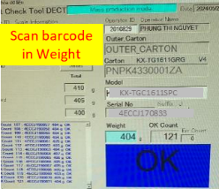
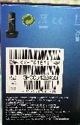
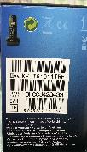


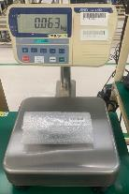
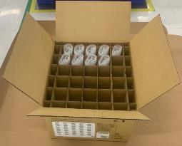

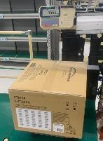

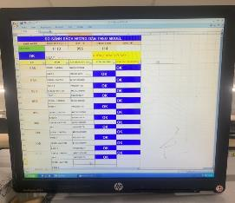
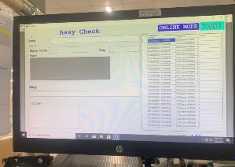
Request modify weight check system (DP, DECT, SB, Service)
BEFORE
AFTER
① No verify matching serial product & serial carton
① Add verify serial product & serial carton
Serial carton
Only scan serial No on Carton box
Scan all serial product & carton box
Merit: ensure inner & outer matching
Risk: Wrong mixing serial product & carton
Base
Remote
Carton
Apply: DP,DECT
② No verify weight of big carton box
② Add verify weight of big carton box
Only weight check single products
Verify weight of each products & total big carton
Merit: no missing products inside
Risk: Missing products inside big carton box
Weigh Product
No weigh total carton
Weigh Product
Weigh total carton
Apply: SB, Service
③ Manual confirm leaflet, book by excel file
③ Add software confirm – link to weight check
Only confirm by excel file
Confirm by software, link to weight check
Merit: traceability system
Risk: loss record file, can not traceability
Apply: DP, DECT, SB

Slide 2
Summary Weight check system all category
① Verify matching serial inner product & serial outer carton
 | TV | DP | DECT | SB | MW | PJ | Service
Weight check | O |  |  | O | O | O | Don’t have product serial
Excel file |  | O | O
Base
Remote
Carton
OK
Need Add
Need Add
OK
OK
OK
OK
② Verify weight of big carton [With many products inside]
 | TV | DP | DECT | SB | MW | PJ | Service
Big carton | None | Have | Have | Have | None | None | Have
Weight check |  | X | X | X |  |  | X
Pallet ID |  | O | O | X |  |  | X
Weigh Product
Weigh total carton
OK
Can control at Pallet ID
Need Add
OK
OK
Need Add
③ Confirm leaflet, manual book
 | TV | DP | DECT | SB | MW | PJ | Service
Leaflet, book | Have | Have | Have | Have | Have | Have | None
Software | O |  |  |  | O | O
Excel |  | O | O | O
Scan on software
OK
Need Soft
Need Soft
Need Soft
OK
OK
OK

